Slide 1
Microservices and Spring Boot

Slide 2
Microservices
Java microservices are a set of software applications written in the Java programming language (and typically leverage the vast ecosystem of Java tools and frameworks), designed for limited scope that work with each other to form a bigger solution.
Microservices represent a design pattern in which each microservice is just one small piece of a bigger overall system.
Microservice is a design pattern and a variant of the Service-Oriented Architecture style
Each microsystem performs a specific and limited scope task that contributes to the end result
As each microservice needs to deliver output data to the next microservice, a microservices architecture often uses a lightweight messaging system for that data handoff.

Slide 3
Microservices
Microservices are small applications that your development teams create independently.
Since they communicate via messaging if at all, they’re not dependent on the same coding language.
Developers can use the programming language that they’re most familiar with. This helps them come work faster, with lower costs and fewer bugs

Slide 4
Java Microservices frameworks
Spring Boot
Jersey
Swagger

Slide 5
Use Cases
Data pipeline with data collection, cleansing, normalization, enrichment, aggregation, reporting, etc.
The microservices workflow naturally creates a trackable lineage so if any problems are encountered in the data, it is relatively easy to trace back which microservice might need to be updated.

Slide 6
Microservices with Spring Boot
Spring Boot gives you Java application to use with your own apps via an embedded server. It uses Tomcat, so you do not have to use Java EE containers.

Slide 7
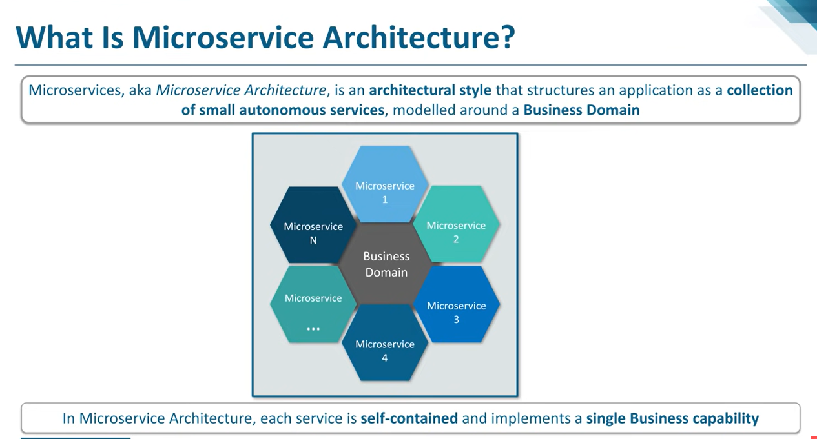

Slide 8
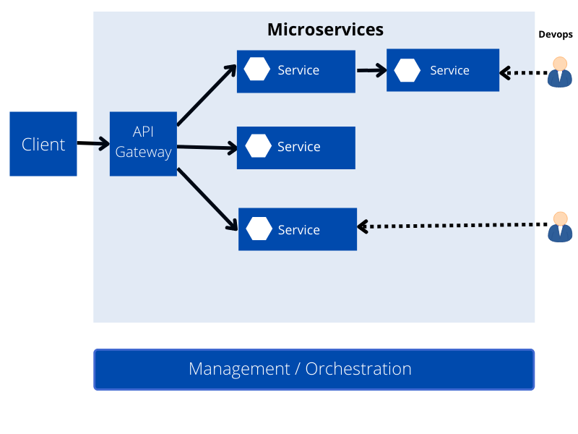
Microservices Architecture

Slide 9
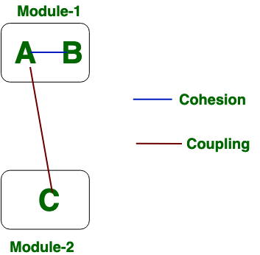
Coupling and Cohesion in Microservices
Coupling talks about how to change one thing needs a change in another, and cohesion talks about how we organize the code. These two terms have also been closely related.
A structure is stable if cohesion is high, and coupling is low.
Cohesion is about how well elements within a module belong together and serve a common purpose. Coupling is about how much one module depends or interacts with other modules. Thus, cohesion is an intra-module concern whereas coupling cuts across modules.

Slide 10
Differentiate between Coupling and Cohesion
Coupling | Cohesion
Coupling is also called Inter-Module Binding. | Cohesion is also called Intra-Module Binding.
Coupling shows the relationships between modules. | Cohesion shows the relationship within the module.
Coupling shows the relative independence between the modules. | Cohesion shows the module's relative functional strength.
While creating, you should aim for low coupling, i.e., dependency among modules should be less. | While creating you should aim for high cohesion, i.e., a cohesive component/ module focuses on a single function (i.e., single-mindedness) with little interaction with other modules of the system.
In coupling, modules are linked to the other modules. | In cohesion, the module focuses on a single thing.

Slide 11
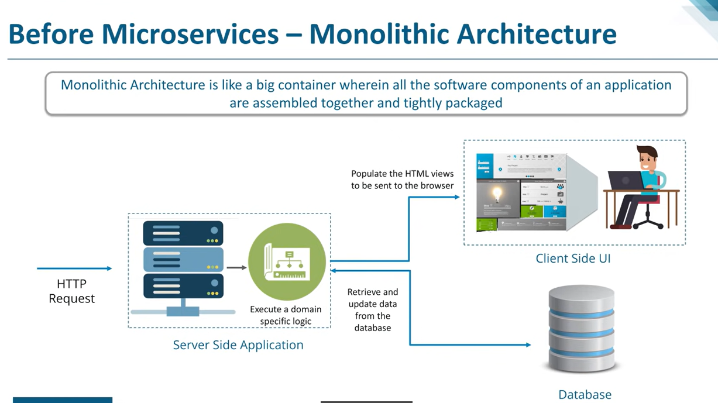
Monolithic Arch

Slide 12
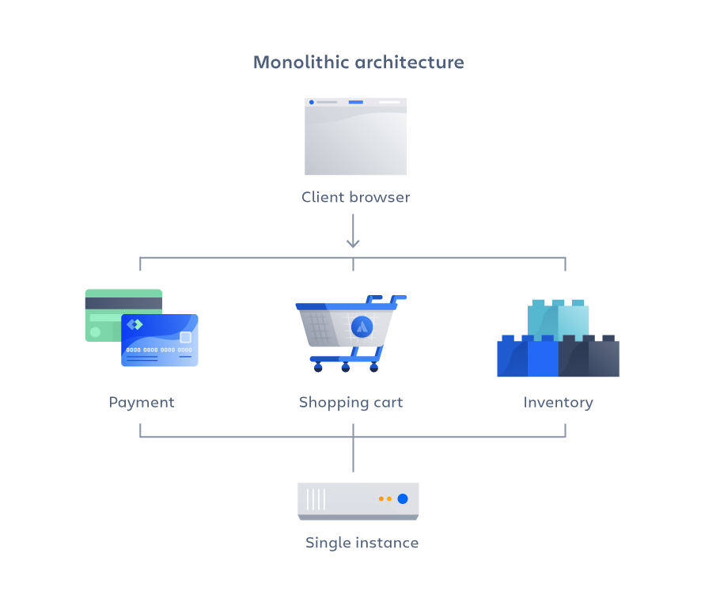
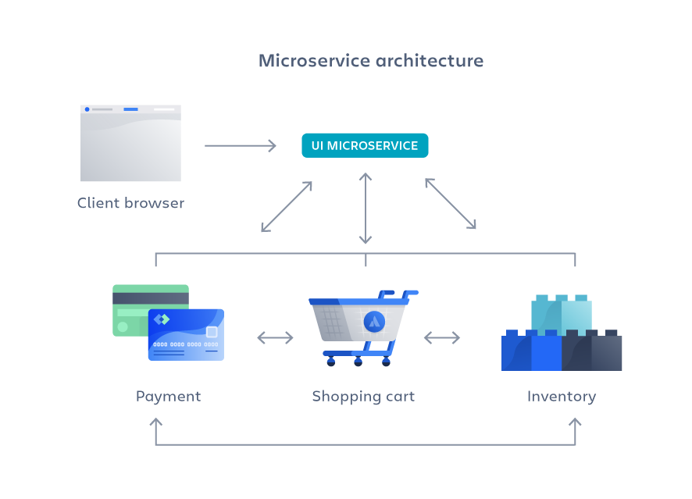
Microservices vs Monolithic Architecture
A monolithic application is built as a single unified unit while a microservices architecture is a collection of smaller, independently deployable services.

Slide 13
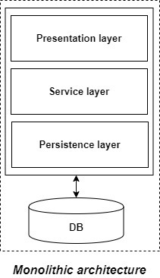
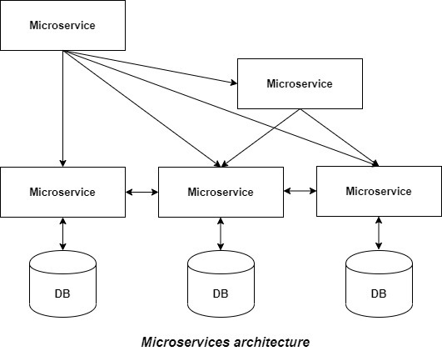
Microservices vs. monolithic architecture

Slide 14
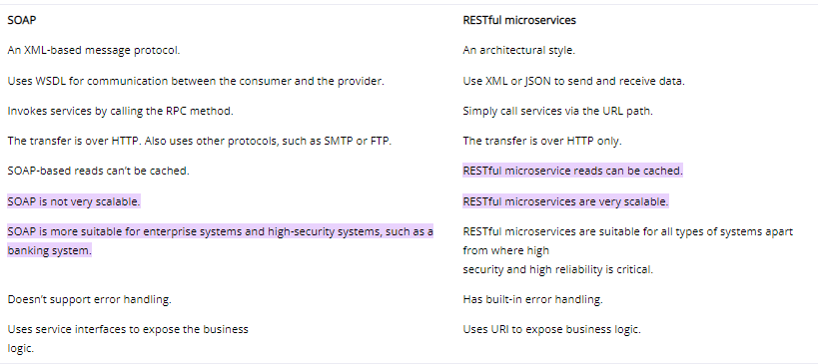
Microservices vs SOAP services

Slide 15
12 Factor App

Slide 16
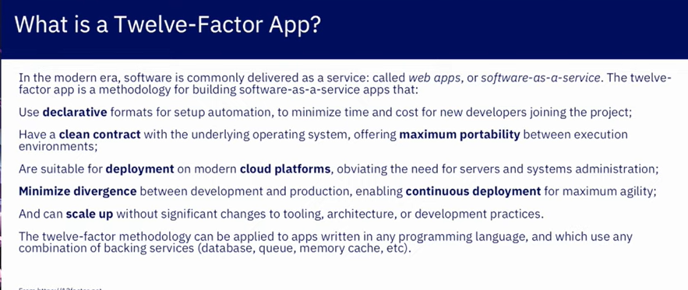

Slide 17
12 factor app
The Twelve Factors
I. Codebase
One codebase tracked in revision control, many deploys
II. Dependencies
Explicitly declare and isolate dependencies
III. Config
Store config in the environment
IV. Backing services
Treat backing services as attached resources
V. Build, release, run
Strictly separate build and run stages
VI. Processes
Execute the app as one or more stateless processes

Slide 18
12 Factor App
VII. Port binding
Export services via port binding
VIII. Concurrency
Scale out via the process model
IX. Disposability
Maximize robustness with fast startup and graceful shutdown
X. Dev/prod parity
Keep development, staging, and production as similar as possible
XI. Logs
Treat logs as event streams
XII. Admin processes
Run admin/management tasks as one-off processes

Slide 19
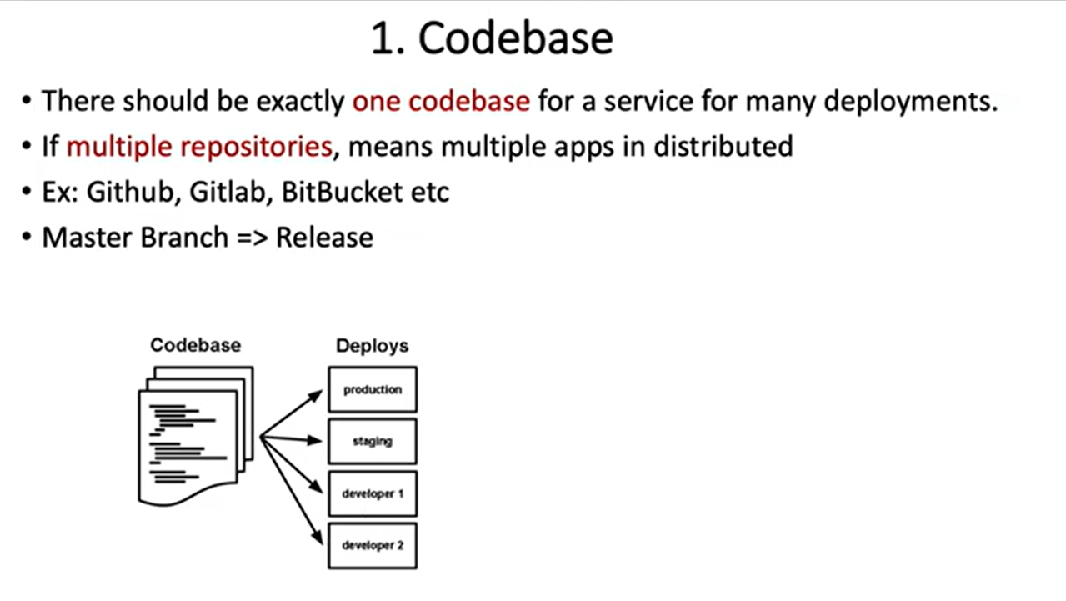

Slide 20
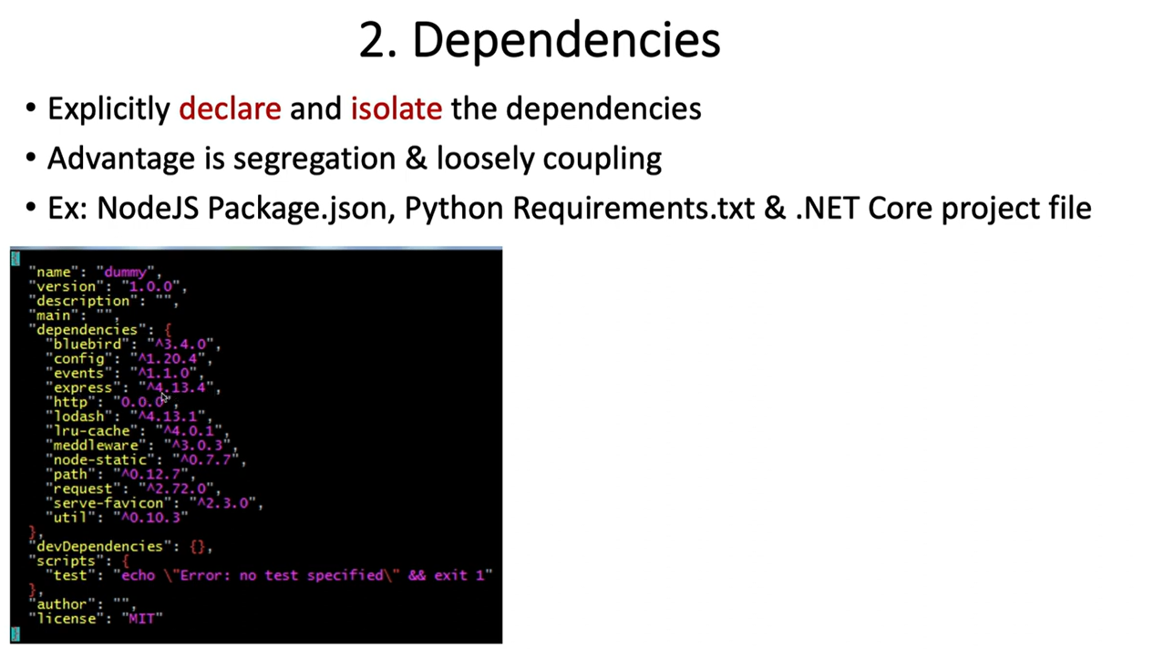

Slide 21
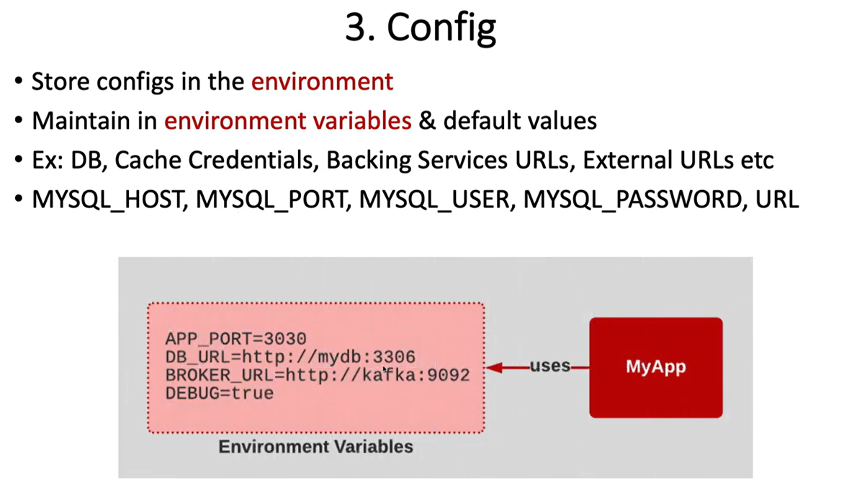

Slide 22
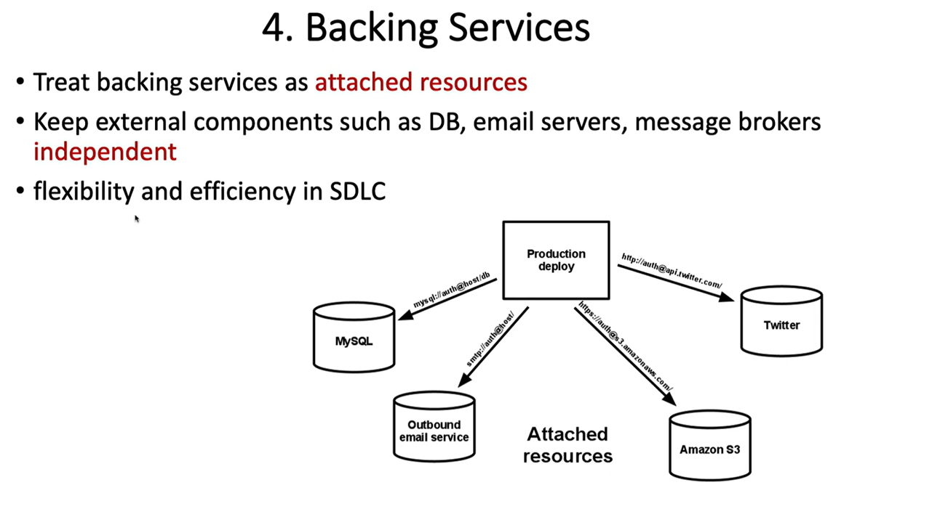

Slide 23
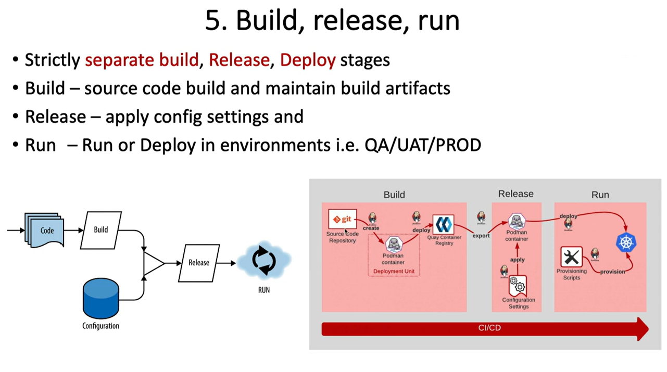

Slide 24
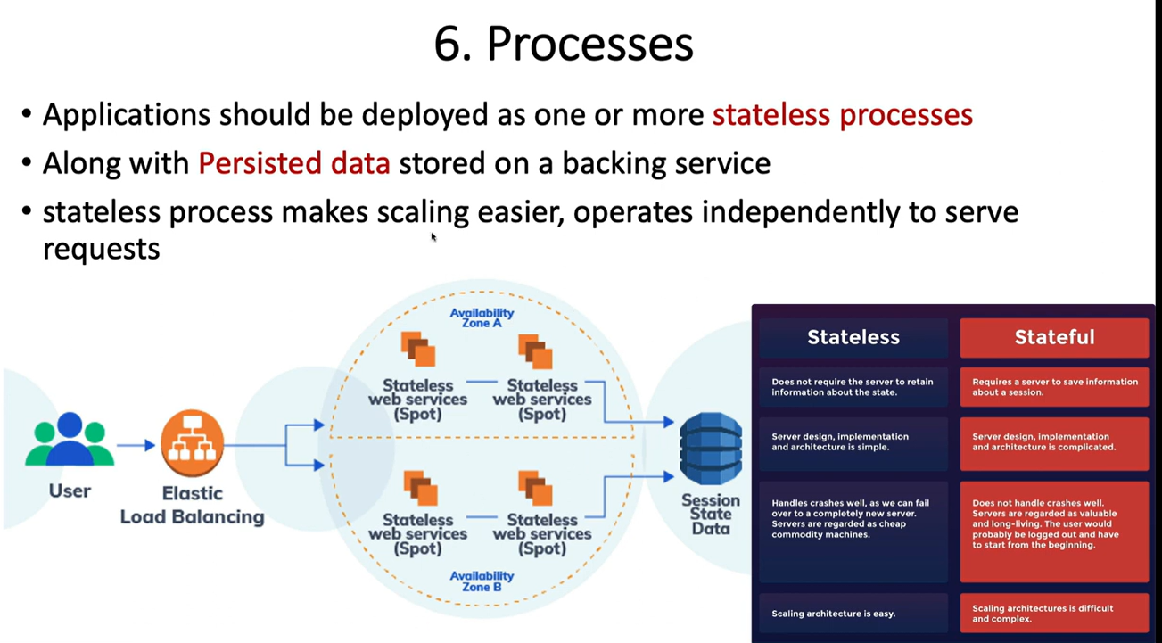

Slide 25
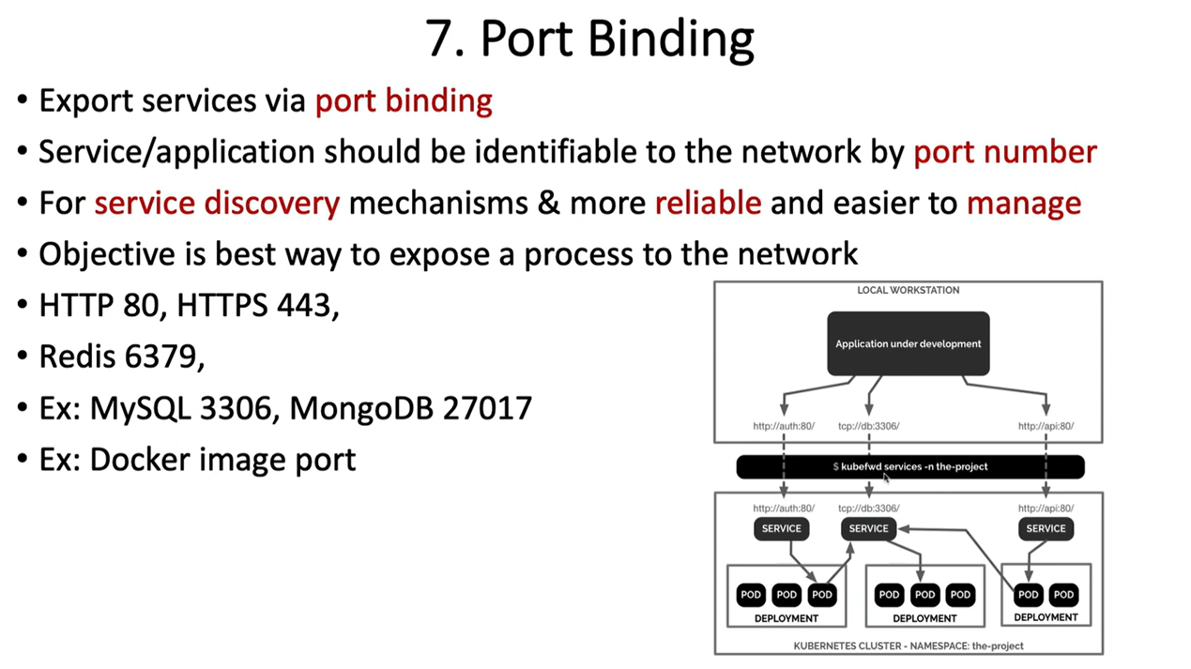

Slide 26
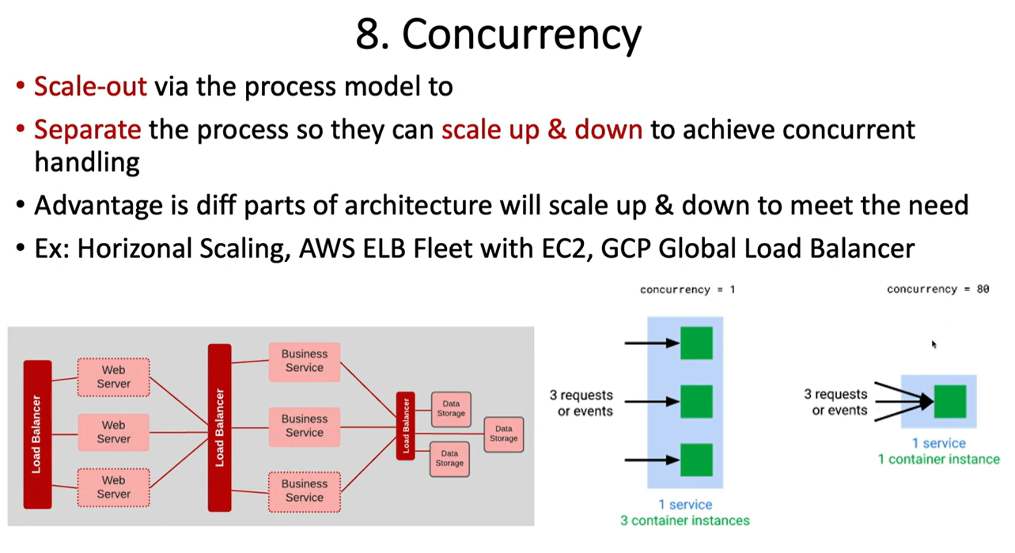

Slide 27
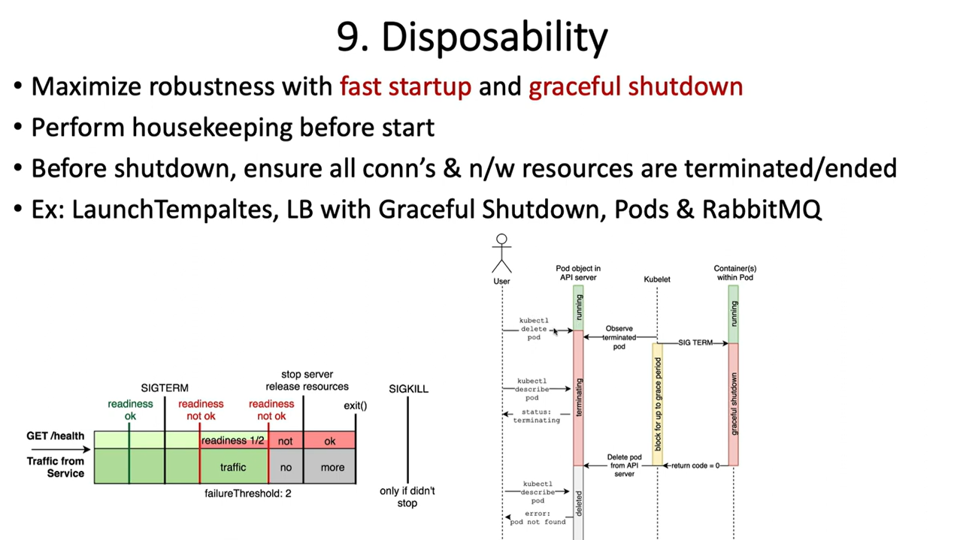

Slide 28
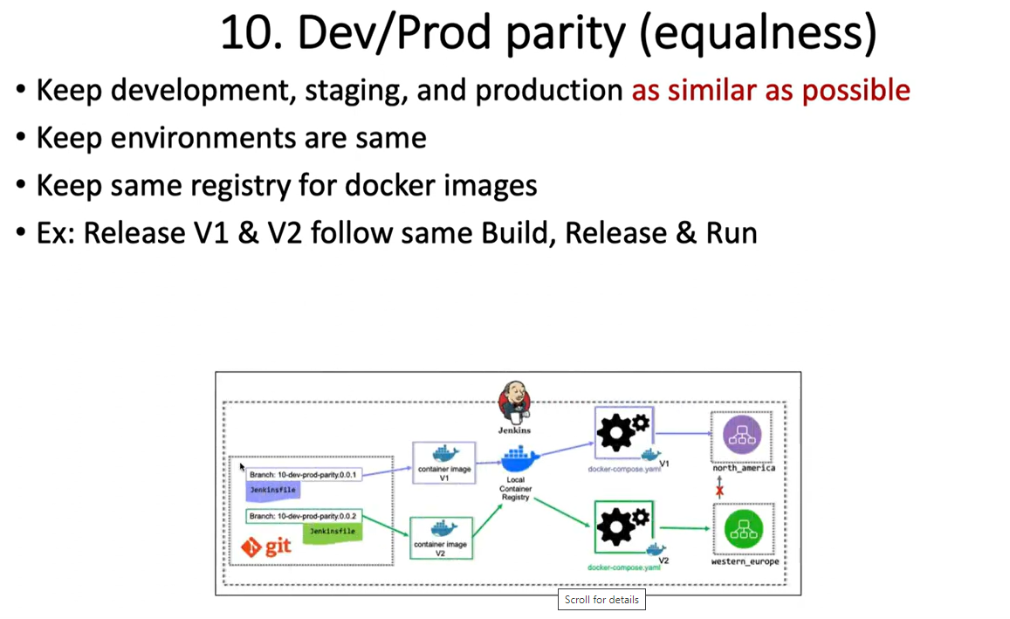

Slide 29
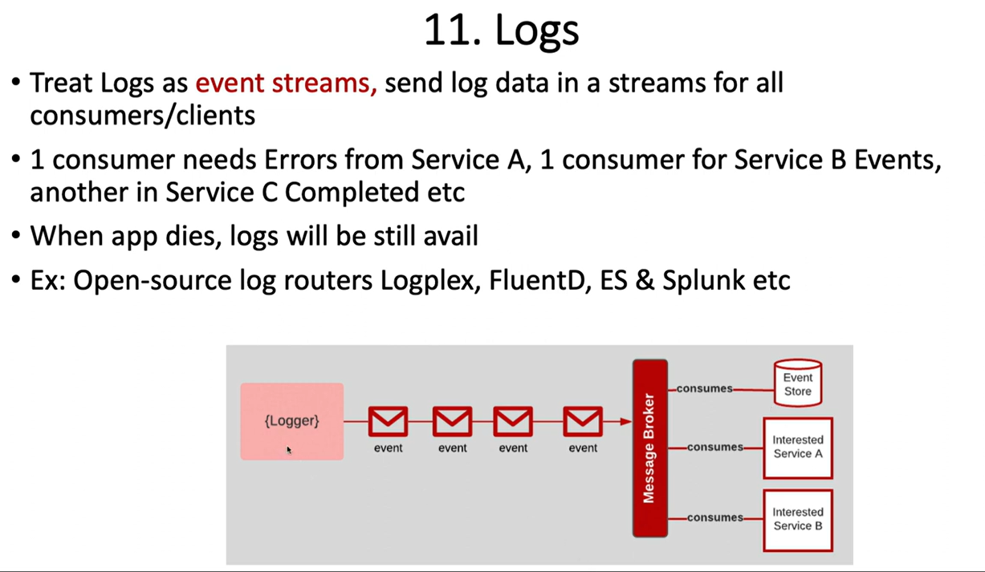

Slide 30
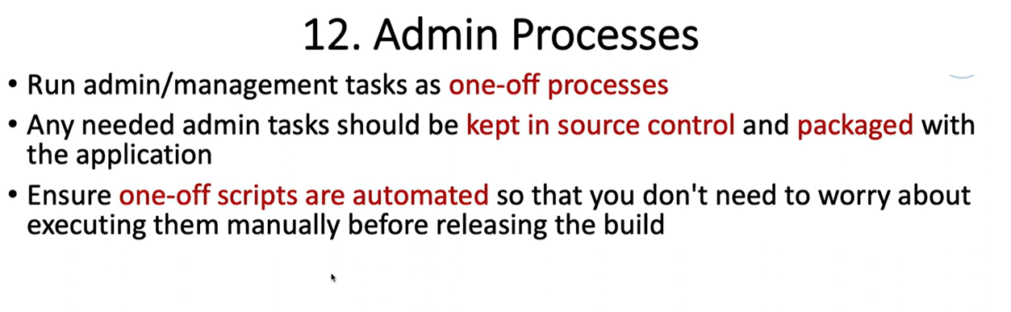

Slide 31
Auto-configuration
Spring Boot auto-configuration attempts to automatically configure your Spring application based on the jar dependencies that you have added.
opt-in to auto-configuration by adding the @EnableAutoConfiguration or @SpringBootApplication annotations to one of your @Configuration classes.
Configuration classes
Spring Boot favors Java-based configuration. Although it is possible to call SpringApplication.run() with an XML source, we generally recommend that your primary source is a @Configuration class. Usually the class that defines the main method is also a good candidate as the primary @Configuration.

Slide 32
Build systems
It is strongly recommended that you choose a build system that supports dependency management, and one that can consume artifacts published to the “Maven Central” repository.
We would recommend that you choose Maven or Gradle.
It is possible to get Spring Boot to work with other build systems (Ant for example), but they will not be particularly well supported.
Dependency management:
Each release of Spring Boot provides a curated list of dependencies it supports.
do not need to provide a version for any of these dependencies in your build configuration as Spring Boot is managing that for you

Slide 33
Dependency Management( Maven)
Maven users can inherit from the spring-boot-starter-parent project to obtain sensible defaults. The parent project provides the following features:
Java 1.6 as the default compiler level.
UTF-8 source encoding.
A Dependency Management section, allowing you to omit <version> tags for common dependencies, inherited from the spring-boot-dependencies POM.
Sensible resource filtering.
Sensible plugin configuration (exec plugin, surefire, Git commit ID, shade).
Sensible resource filtering for application.properties and application.yml

Slide 34
Inheriting the starter parent
To configure your project to inherit from the spring-boot-starter-parent simply set the parent:
<!-- Inherit defaults from Spring Boot -->
<parent>
<groupId>org.springframework.boot</groupId>
<artifactId>spring-boot-starter-parent</artifactId>
<version>1.3.8.RELEASE</version>
</parent>

Slide 35
Changing the Java version
The spring-boot-starter-parent chooses fairly conservative Java compatibility. If you want to follow our recommendation and use a later Java version you can add a java.version property:
<properties>
<java.version>1.8</java.version>
</properties>

Slide 36
Using the Spring Boot Maven plugin
Spring Boot includes a Maven plugin that can package the project as an executable jar. Add the plugin to your <plugins> section if you want to use it:
<build>
<plugins>
<plugin>
<groupId>org.springframework.boot</groupId>
<artifactId>spring-boot-maven-plugin</artifactId>
</plugin>
</plugins>
</build>

Slide 37
Spring Boot application starters
Name | Description
spring-boot-starter | The core Spring Boot starter, including auto-configuration support, logging and YAML.
spring-boot-starter-actuator | Production ready features to help you monitor and manage your application.
spring-boot-starter-aop | Support for aspect-oriented programming including spring-aop and AspectJ.
spring-boot-starter-data-jpa | upport for the “Java Persistence API” including spring-data-jpa, spring-orm and Hibernate.
spring-boot-starter-data-rest | Support for exposing Spring Data repositories over REST via spring-data-rest-webmvc.
spring-boot-starter-jdbc | Support for JDBC databases.
spring-boot-starter-security | Support for spring-security.
spring-boot-starter-social-facebook | Support for spring-social-facebook.
spring-boot-starter-test | Support for common test dependencies, including JUnit, Hamcrest and Mockito along with the spring-test module.
spring-boot-starter-web | Support for full-stack web development, including Tomcat and spring-webmvc.
spring-boot-starter-ws | Support for Spring Web Services.

Slide 38
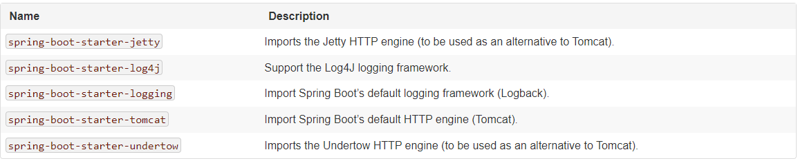
Spring Boot technical starters

Slide 39
Spring Beans and dependency injection
You are free to use any of the standard Spring Framework techniques to define your beans and their injected dependencies.
For simplicity, we often find that using @ComponentScan to find your beans, in combination with @Autowired constructor injection works well.
All of your application components (@Component, @Service, @Repository, @Controller etc.) will be automatically registered as Spring Beans.

Slide 40
Using the @SpringBootApplication annotation
The @SpringBootApplication annotation is equivalent to using @Configuration, @EnableAutoConfiguration and @ComponentScan with their default attributes:
package com.example.myproject;
import org.springframework.boot.SpringApplication;
import org.springframework.boot.autoconfigure.SpringBootApplication;
@SpringBootApplication // same as @Configuration @EnableAutoConfiguration @ComponentScan
public class Application {
public static void main(String[] args) {
SpringApplication.run(Application.class, args);
}
}

Slide 41
Running spring boot application
Running as a packaged application:
Mavn: java -jar target/myproject-0.0.1-SNAPSHOT.jar
2. Using the Maven plugin:
mvn spring-boot:run

Slide 42


Slide 43
Spring Data JPA
Spring Data JPA API provides JpaTemplate class to integrate spring application with JPA.
JPA (Java Persistent API) is the sun specification for persisting objects in the enterprise application. It is currently used as the replacement for complex entity beans.
The implementation of JPA specification are provided by many vendors such as:
Hibernate
Toplink
iBatis
OpenJPA etc.

Slide 44
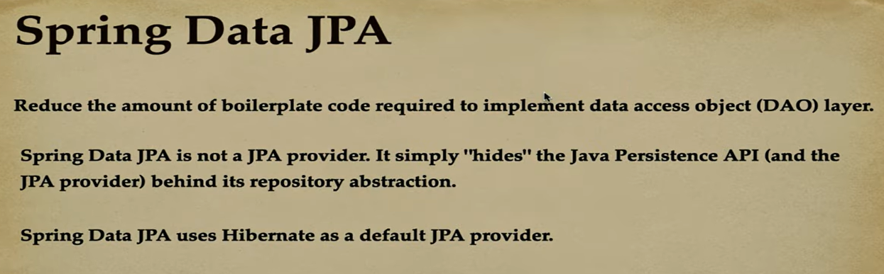
Spring Data JPA

Slide 45




Slide 46
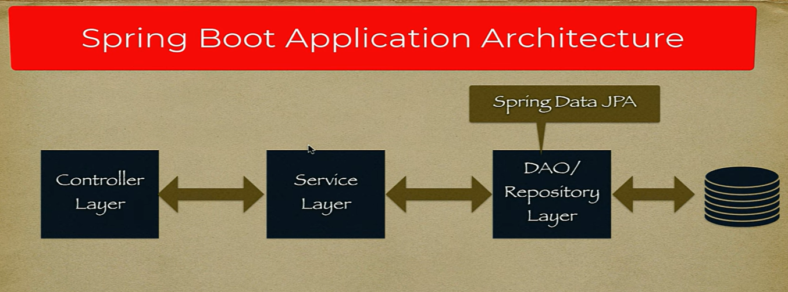

Slide 47
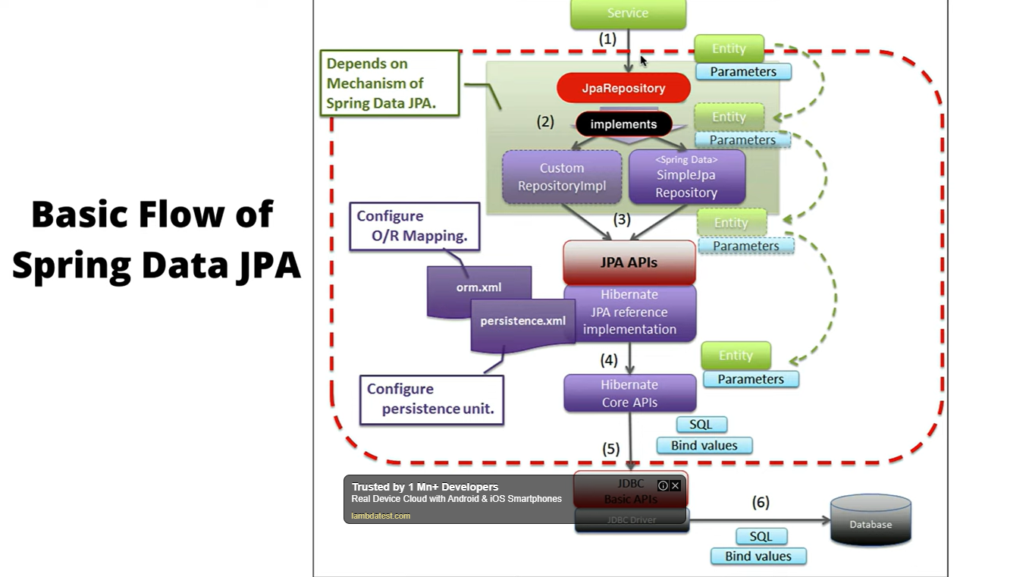

Slide 48
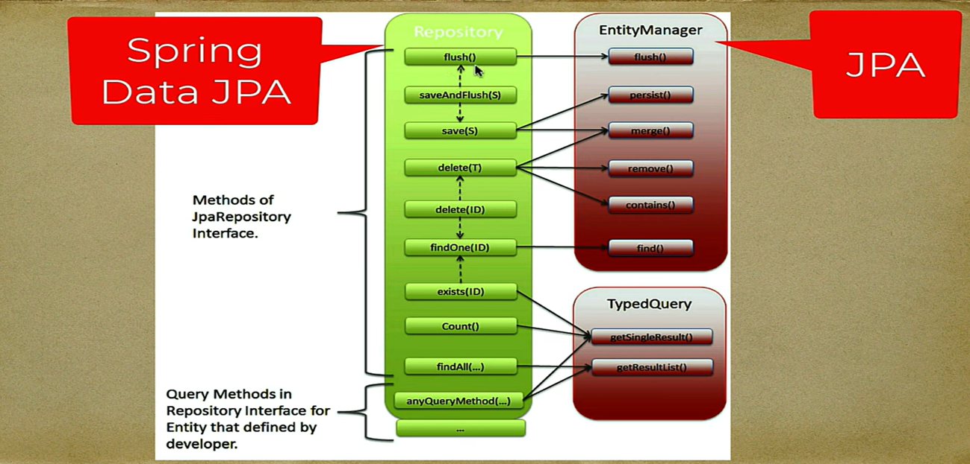

Slide 49
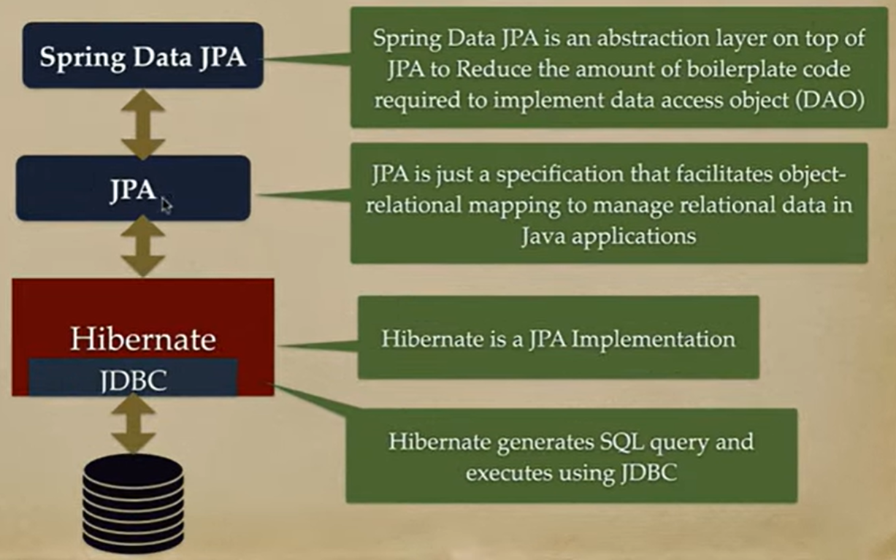

Slide 50
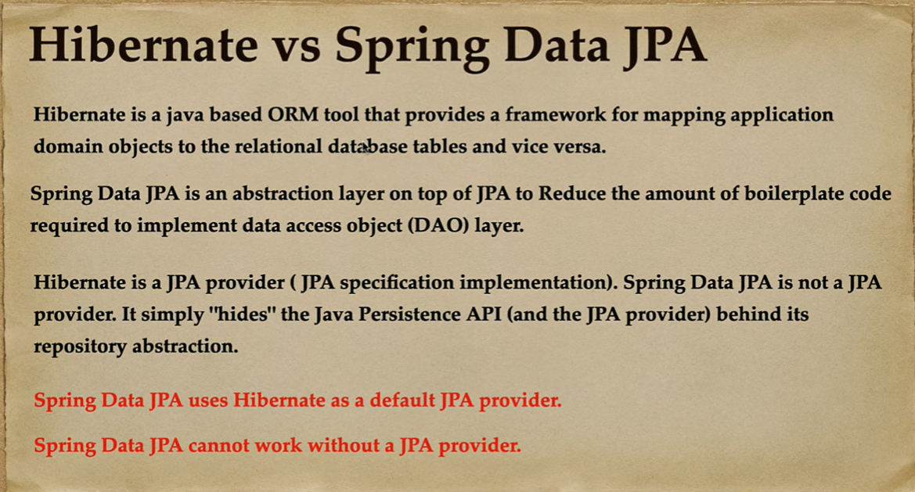

Slide 51
Spring Data JPA
No need to write the before and after code for persisting, updating, deleting or searching object such as creating Persistence instance, creating EntityManagerFactory instance, creating EntityTransaction instance, creating EntityManager instance, commiting EntityTransaction instance and closing EntityManager.

Slide 52
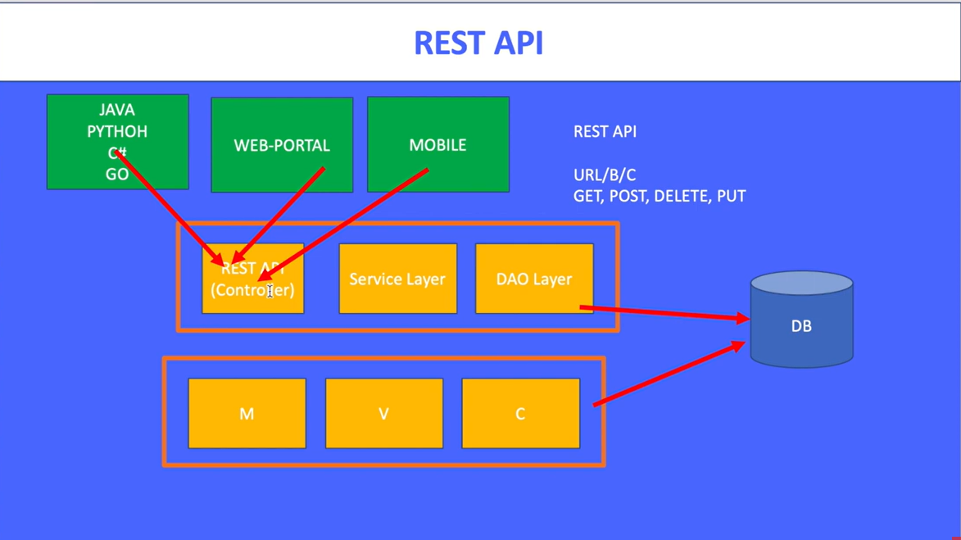

Slide 53
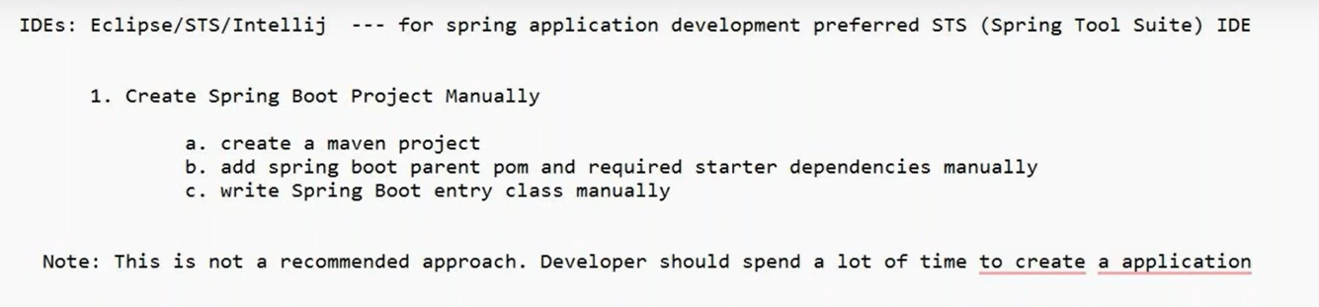
Create SB APP– APPROACH-1

Slide 54
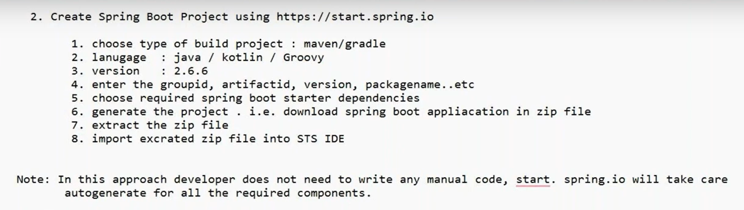
APPROACH-2

Slide 55
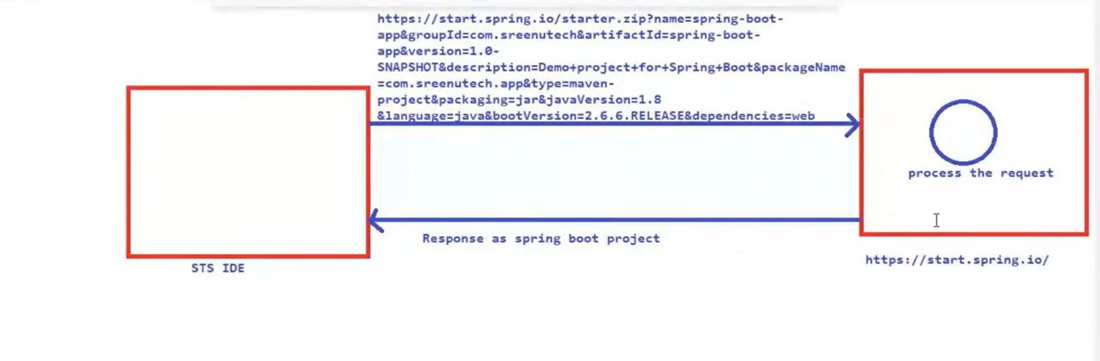
APPROACH-2

Slide 56
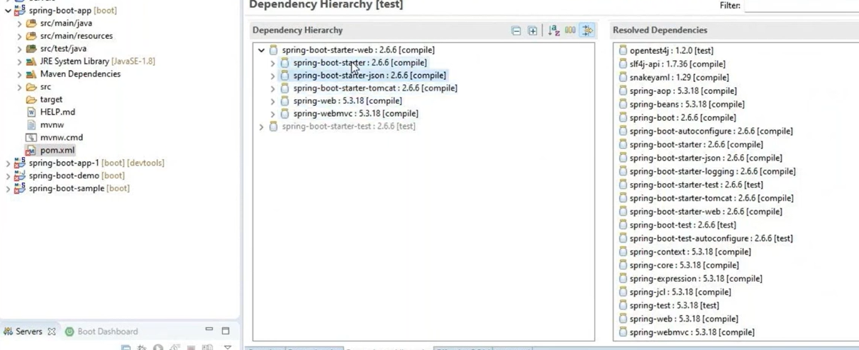
SPRING WEB DEPENDENCIES ADDED

Slide 57
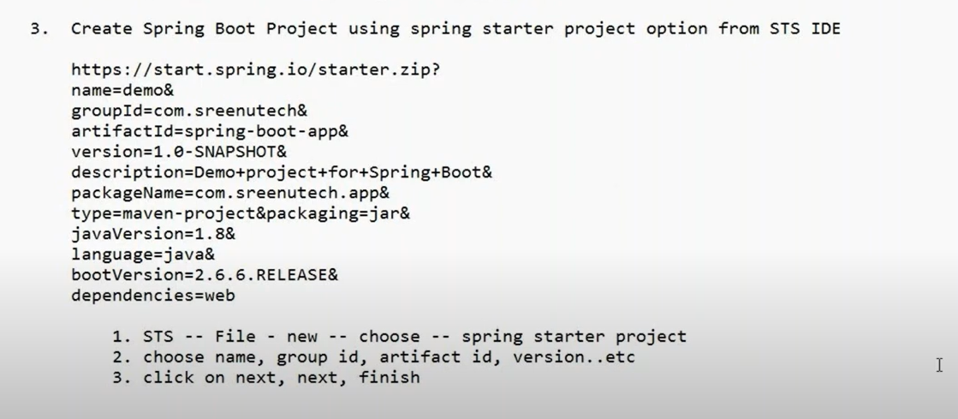
APPROACH-3

Slide 58
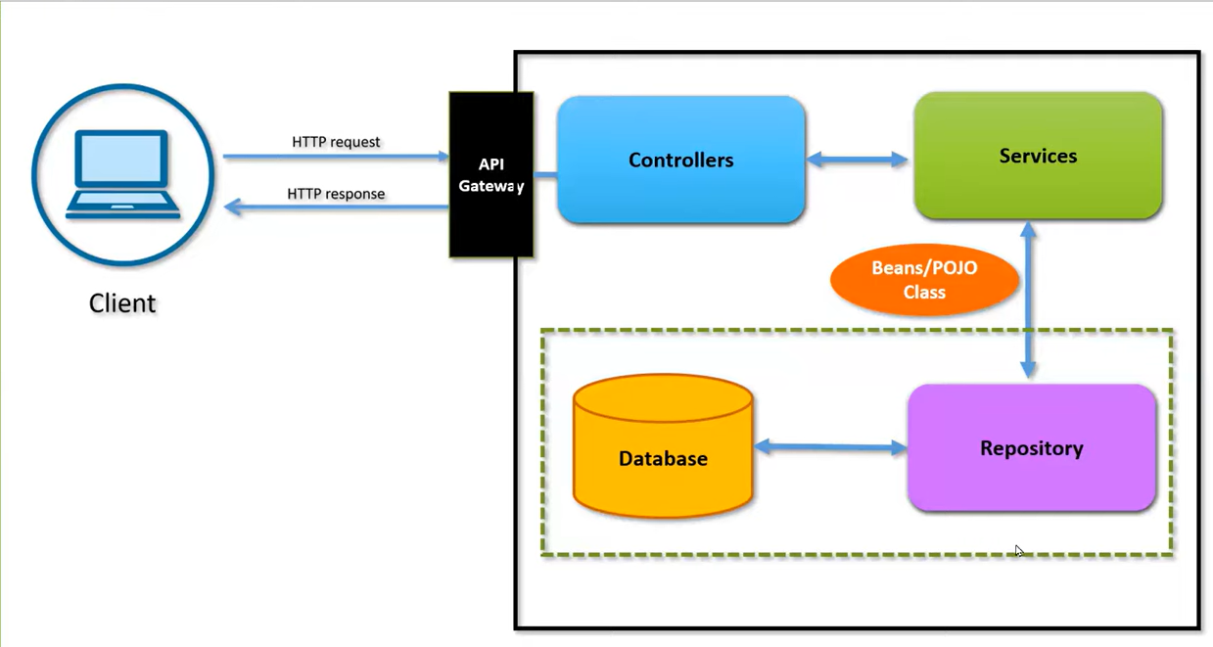
Microservices- Spring REST - HashMap

Slide 59
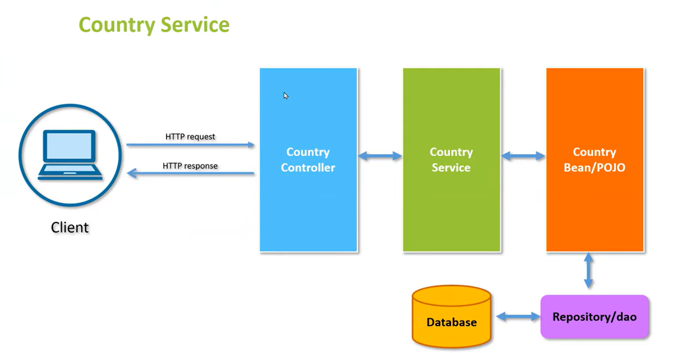

Slide 60
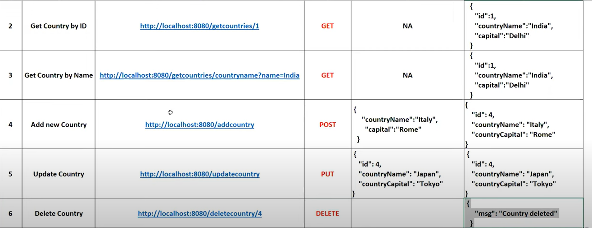

Slide 61
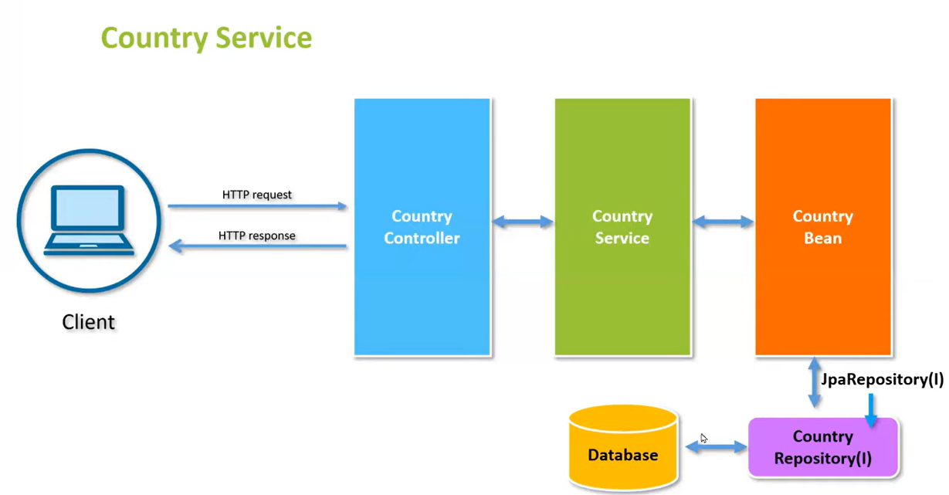

Slide 62
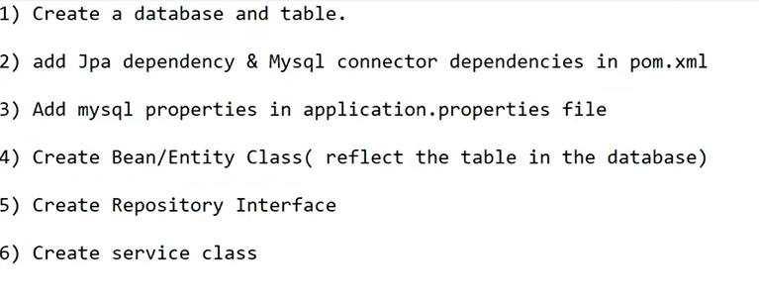

Slide 63
Fat Jar
Spring Boot is known for its “fat” JAR deployments, where a single executable artifact contains both the application code and all of its dependencies.
An uber-JAR—also known as a fat JAR or JAR with dependencies—is a JAR file that contains not only a Java program, but embeds its dependencies as well.
his means that the JAR functions as an “all-in-one” distribution of the software, without needing any other Java code.
A Fat JAR is a single JAR file that contains all the compiled Java classes from your project, and all compiled Java classes from all JAR files your project depends on (see Maven Dependencies).

Slide 64
Fat Jar-Maven
<plugin>
<groupId>org.apache.maven.plugins</groupId>
<artifactId>maven-shade-plugin</artifactId>
<version>2.4.3</version>
<executions>
<execution>
<phase>package</phase>
<goals>
<goal>shade</goal>
</goals>
<configuration>
<shadedArtifactAttached>true</shadedArtifactAttached>
<shadedClassifierName>all</shadedClassifierName>
<transformers>
<transformer implementation="org.apache.maven.plugins.shade.resource.ManifestResourceTransformer">
<mainClass>com.mycompany.myproduct.Main</mainClass>
</transformer>
</transformers>
</configuration>
</execution>
</executions>
</plugin>

Slide 65
Thin Jar
Thin Jar represents a compiled and packaged application code (business logic) of the project together with the third party libraries it depends on. Compared to Fat, it does not contain application server runtime by default, so the size of a Thin archive is much smaller.

Slide 66
Validation in Spring Boot REST API with Hibernate Validator (Java Bean Validation Annotations)
@NotNull validates that the annotated property value is not null.
@Size validates that the annotated property value has a size between the attributes min and max; can be applied to String, Collection, Map, and array properties.
@Min validates that the annotated property has a value not smaller than the value attribute.
@Max validates that the annotated property has a value no larger than the value attribute.
@Email validates that the annotated property is a valid email address.
@NotEmpty validates that the property is not null or empty; can be applied to String, Collection, Map, or Array values.
@NotBlank can be applied only to text values and validates that the property is not null or whitespace.

Slide 67
Content Negotiation
Content negotiation is the process of selecting the best representation for a given response when there are multiple representations available.
It is a part of HTTP that makes it possible to serve different versions of a document at the same URI.
It is useful e.g. for writing Web Services supporting several output formats (XML, JSON, etc.).
Server-driven negotiation is essentially performed using the Accept* requests headers.

Slide 68
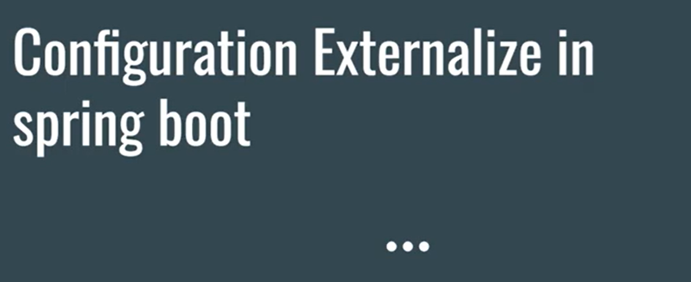

Slide 69
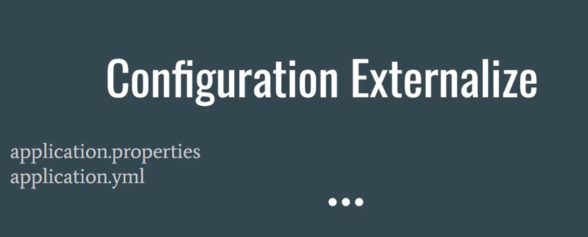

Slide 70
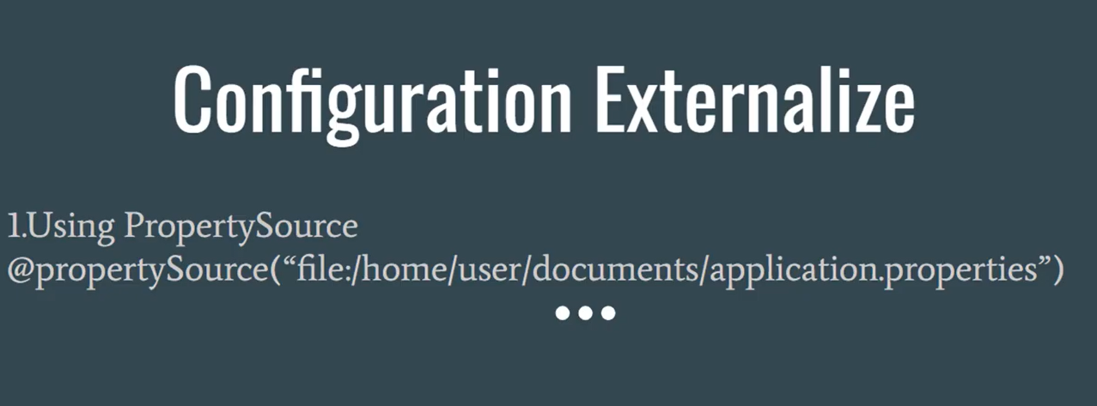

Slide 71
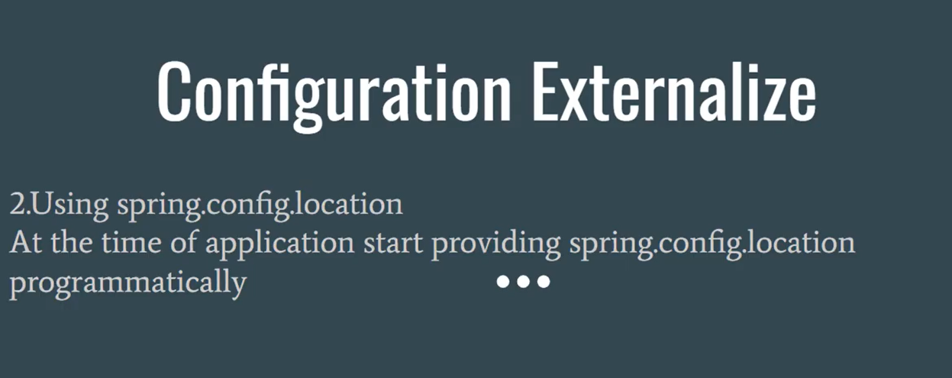

Slide 72
@Query Annotation
The @Query annotation is applied at the method-level in JpaRepository interfaces, and pertain to a single method.
The language used inside of the annotation depends on your back-end, or you can use the neutral JPQL (for relational databases).
The @Query annotation declares finder queries directly on repository methods.
Spring Data JPA @Query annotation is used on Repository interface.

Slide 73
@Query ANNotation
When you can not use the query methods to perform database operations, @Query could be used to write the more flexible query to fetch data.
@Query annotation supports both JPQL and native SQL queries.
By default, @Query annotation will be using JPQL to execute the queries. If you try to use the normal SQL queries, you would get the query syntax error exceptions.
If you want to write native SQL queries, set the nativeQuery flag to true.
Like expressions allowed in @query notation.

Slide 74
JPQL Queries
JPQL stands for the Java Persistence Query Language. It is defined in the JPA specification and is an object-oriented query language used to perform database operations on persistent entities.
Add a query method to our repository interface.
Annotate the query method with the @Query annotation, and specify the invoked query by setting it as the value of the @Query annotation.
interface TodoRepository extends Repository<Todo, Long> {
@Query("SELECT t FROM Todo t WHERE t.title = 'title'")
public List<Todo> findByTitle();
}

Slide 75
SQL Queries
Add a query method to our repository interface.
Annotate the query method with the @Query annotation, and specify the invoked query by setting it as the value of the @Query annotation's value attribute.
Set the value of the @Query annotation’s nativeQuery attribute to true.
interface TodoRepository extends Repository<Todo, Long> {
@Query(value = "SELECT * FROM todos t WHERE t.title = 'title'",
nativeQuery=true
)
public List<Todo> findByTitle();
}

Slide 76
JPA Query methods
Spring Data JPA query methods are the most powerful methods, we can create query methods to select records from the database without writing SQL queries. Behind the scenes, Spring Data JPA will create SQL queries based on the query method and execute the query for us.
The query generation from the method name is a query generation strategy where the invoked query is derived from the name of the query method.
We can create query methods for the repository using Entity fields and creating query methods is also called finder methods ( findBy, findAll …)

Slide 77
JPA Query Methods
public interface UserRepository extends Repository<User, Long> {
List<User> findByEmailAddressAndLastname(String emailAddress, String lastname);
}
Spring Data JPA behind the scene creates a query using the JPA criteria API from the above query method (findByEmailAddressAndLastname), but, essentially, this translates into the following JPQL query: select u from User u where u.emailAddress = ?1 and u.lastname = ?2.

Slide 78
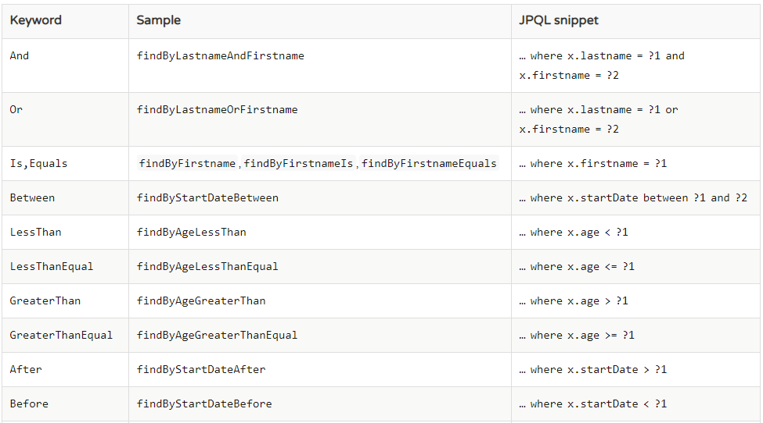
Query Methods

Slide 79
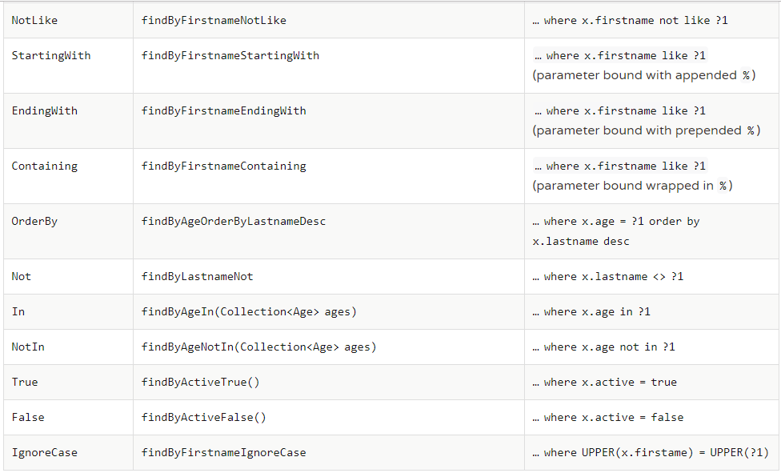
Query Methods

Slide 80
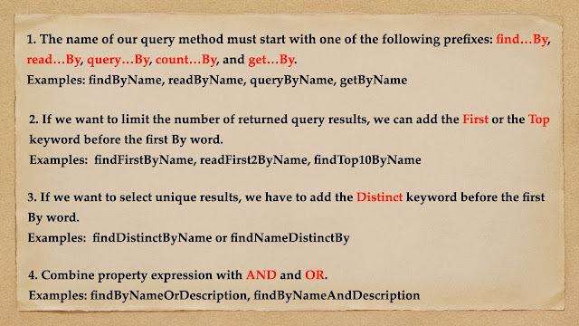
Rules for Creating Query Methods

Slide 81
Spring Boot Caching
Spring Framework provides caching in a Spring Application, transparently.
In Spring, the cache abstraction is a mechanism that allows consistent use of various caching methods with minimal impact on the code.
Cache Abstraction:
The main objective of using cache abstraction is to reduce the number of executions based on the information present in the cache.
It applies to expensive methods such as CPU or IO bound.

Slide 82
Cache Declaration: It identifies the methods that need to be cached.
Cache Configuration: The backing cache where the data is stored and read from.
Types of Caching
There are four types of caching are as follows:
In-memory Caching
Database Caching
Web server Caching
CDN Caching

Slide 83
SPRING CACHE ANNOTATIONS

Slide 84
@Cacheable
It is a method level annotation. It defines a cache for a method's return value.
The Spring Framework manages the requests and responses of the method to the cache that is specified in the annotation attribute.
The @Cacheable annotation contains more options. For example, we can provide a cache name by using the value or cacheNames attribute.
We can also specify the key attribute of the annotation that uniquely identifies each entry in the cache. If we do not specify the key, Spring uses the default mechanism to create the key.
@Cacheable(value="cacheStudentInfo", key="#id")
public List studentInfo()
{
//some code
return studentDetails;
}

Slide 85
Spring boot Cache Annotations
We can also apply a condition in the annotation by using the condition attribute. When we apply the condition in the annotation, it is called conditional caching.
@Cacheable(value="student", condition="#name.length<20")
public Student findStudent(String name)
{
//some code
}

Slide 86
Spring Boot Cache Annotations
@EnableCaching
It is a class-level annotation. We can enable caching in the Spring Boot application by using the annotation @EnableCaching. It is defined in org.springframework.cache.annotation package.
It is used together with @Configuration class.
@CacheConfig
It is a class-level annotation that provides a common cache-related setting. It tells the Spring where to store cache for the class. When we annotate a class with the annotation, it provides a set of default settings for any cache operation defined in that class. Using the annotation, we need not to declare things multiple times.
@CachePut
It is a method level annotation. It is used when we want to update the cache without interfering the method execution. It means the method will always execute, and its result will be placed into the cache. It supports the attributes of @Cacheable annotation.

Slide 87
Spring Boot Cache Dependency
<dependency>
<groupId>org.springframework.boot</groupId>
<artifactId>spring-boot-starter-cache</artifactId>
</dependency>

Slide 88
Spring Profiles
Spring Profiles provides a powerful and easy way to control code and configuration based on the environment.
Using Spring Profiles it’s possible to segregate parts of our application and make it only available in certain environments.
We can use @Profile annotation to limit the availability of any @Component or @Configuration.

Slide 89
@profile Annotation
Main entry point for the Spring Profile is @Profile annotation which can be used to group things together.
To make DB Connection active only in DEV env not in test/prod
@Service
@Profile("development")
public class DevDBConnection implements DatabaseService
{ @Override
public void getDBConnection()
{ System.out.println("DEV DB connection established");
}
}

Slide 90
Ways to active profile
Using command line:
—spring.profiles.active=development
Using Property File:
spring.profiles.active=development
Programmatically setting profile:
SpringApplication app = new SpringApplication(Application.class);app.setAdditionalProfiles("development","production");

Slide 91
Spring Boot Application Configuration with YAML
YAML stands for Yet Another Markup Language or YAML ain’t markup language (a recursive acronym), which emphasizes that YAML is for data, not documents.
YAML is a data serialization language that is often used for writing configuration files.
So YAML configuration file in Spring Boot provides a very convenient syntax for storing logging configurations in a hierarchical format.
YAML is more readable and it is good for the developers to read/write configuration files.
YAML is case sensitive.
YAML is language independent. If we define the YAML once, the same YAML file can be invoked in Python file, Ruby, etc.

Slide 92
What is YAML?
YAML is a human readable serialization language
YAML stands for Yet Another Markup Language

Slide 93
application.properties
level1.property1 = 5
level1.property2 = 6
level1.property3 = 7
level1.level2.property4 = 8
level1.level2.property5 = 10
level1.level2.property6 = 11
server.port = 9080

Slide 94
application.yaml
level1:
property1: 5
property2: 6
property3: 7
level2:
property4: 8
property5: 10
property6: 11
server:
port: 9080

Slide 95
Another example for application.properties
app.name= myapp
app.description=${app.name} is your first Spring Boot application
welcome.message=Welcome message from property file! Welcome to ${app.name}

Slide 96
Application.yaml
app:
name: myapp
description: ${app.name} is your first Spring Boot application
welcome:
message: Welcome to your first Spring Boot app!

Slide 97
Dynamic Configuration
basic.value: true
basic.message: Dynamic Message
basic.number: 100

Slide 98
yaml
basic:
value: true
message: Dynamic Message YAML
number: 100

Slide 99
YAML
is concise
is more readable

Slide 100
Swagger2 Dependency
<dependency>
<groupId>io.springfox</groupId>
<artifactId>springfox-swagger2</artifactId>
<version>2.4.0</version>
</dependency>
<dependency>
<groupId>io.springfox</groupId>
<artifactId>springfox-swagger-ui</artifactId>
<version>2.4.0</version>
</dependency>

Slide 101
Mockito
Mockito is a mocking framework, JAVA-based library that is used for effective unit testing of JAVA applications.
Mockito is used to mock interfaces so that a dummy functionality can be added to a mock interface that can be used in unit testing.
How to create unit tests with Mockito as well as how to use its APIs in a simple and intuitive way.

Slide 102
What is Mocking?
Mocking is a way to test the functionality of a class in isolation.
Mocking does not require a database connection or properties file read or file server read to test a functionality.
Mock objects do the mocking of the real service.
A mock object returns a dummy data corresponding to some dummy input passed to it.

Slide 103
Mockito
Mockito is an open-source testing framework used for unit testing of Java applications.
It plays a vital role in developing testable applications.
Mockito is used to mock interfaces so that a dummy functionality can be added to a mock interface that can be used in Unit Testing.
The primary objective of using the Mockito framework is to simplify the development of a test by mocking external dependencies and using them in the test code.
use @Mock to create and inject mocked instances without having to call Mockito.mock manually.
@InjectMocks annotation to inject mock fields into the tested object automatically.
@Mock creates a mock, and @InjectMocks creates an instance of the class and injects the mocks that are created with the @Mock annotations into this instance.

Slide 104
@Mock
It is used to mock the objects that helps in minimizing the repetitive mock objects.
It makes the test code and verification error easier to read as parameter names (field names) are used to identify the mocks.
The @Mock annotation is available in the org.mockito package.
Mock: a dummy piece of code that you verify is called correctly as part of the test. Substitutes for real working code.
A mock is a fake class that can be examined after the test is finished for its interactions with the class under test. For example, you can ask it whether a method was called or how many times it was called.

Slide 105
@InjectMocks
It marks a field or parameter on which the injection should be performed.
It allows shorthand mock and spy injections and minimizes the repetitive mocks and spy injection.
In Mockito, the mocks are injected either by setter injection, constructor injection, and property injection.
The @InjectMocks annotation is available in the org.mockito package.

Slide 106
stub
A stub is a fake class that comes with preprogrammed return values.
It's injected into the class under test to give you absolute control over what's being tested as input.
A typical stub is a database connection that allows you to mimic any scenario without having a real database
Stub: a dummy piece of code that lets the test run, but you don't care what happens to it. Substitutes for real working code.
Stubs are the objects that hold predefined data and uses it to give responses during tests. In other words, a stub is an object that resembles a real object with the minimum number of methods needed for a test.

Slide 107
MockMvc
MockMvc is a Spring Boot test tool class that lets you test controllers without needing to start an HTTP server.
In these tests the application context is loaded and you can test the web layer as if i's receiving the requests from the HTTP server without the hustle of actually starting it.
MockMvc provides support for Spring MVC testing. It encapsulates all web application beans and makes them available for testing.
jsonPath, which extracts the response content and provides the requested value.

Slide 108
MockBean
@MockBean annotation is used to create and place mocks into Spring Application Contexts. If Spring Application Context does already have a bean of the same type then this bean will be replaced with a mock object. Otherwise, a new bean(mock) will be created and added to Spring Application Context.

Slide 109
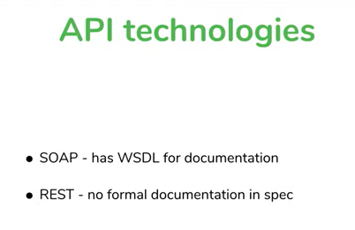

Slide 110
WADL
WADL is acronym for Web Application Description Language.
WADL is championed by Sun Microsystems. WADL is lightweight, easier to understand, and easier to write than WSDL.
In some respects, it is not as flexible as WSDL (no binding to SMTP servers), but it is sufficient for any REST service and much less verbose.
WADL is a machine readable XML description of HTTP based web-services.
WADL is intended to simplify the reuse of web services that are based on the existing HTTP architecture of the Web.
It is platform and language independent and aims to promote the reuse of applications beyond the basic use in a web browser.
WADL was submitted to the World Wide Web Consortium by Sun Microsystems on 31 August, 2009, however the consortium has no current plans to standardize it.
The service is described using a set of resource elements.
Each resource contains param elements to describe the inputs, and method elements which describe the request and response of a resource.

Slide 111
Swagger for Rest api documentation
Swagger is a specification for documenting REST API. It specifies the format (URL, method, and representation) to describe REST web services.
Swagger is the most popular tool for designing, building and documenting RESTful APIs. It has nice integration with Spring Boot.
It also provides tools to generate/compute the documentation from the application code.
As an application developer, we write web services using a framework, Swagger scans application code, and exposes the documentation on URL.
A client can consume this URL and learn how to use REST web services: which HTTP methods to call on which URL, which input documents to send, which status code to expect, etc.

Slide 112
What is Swagger?
Swagger is an open-source tool to develop APIs, interact with APIs, and mainly generate documentation for APIs.
Swagger (now the “Open API Initiative”) is a specification and framework for describing REST APIs using a common language that everyone can understand.
Swagger is an open source software framework backed by a large ecosystem of tools that helps developers design, build, document, and consume RESTful Web services.
Swagger-UI is for visual display which is easy for humans to understand by just browsing the api documentation.

Slide 113
Spring Boot + Swagger2
Swagger is widely used for visualizing APIs, and with Swagger UI it provides online sandbox for frontend developers.
Swagger is a tool, a specification and a complete framework implementation for producing the visual representation of RESTful Web Services.
It enables documentation to be updated at the same pace as the server.
When properly defined via Swagger, a consumer can understand and interact with the remote service with a minimal amount of implementation logic.
Thus Swagger removes the guesswork in calling the service.

Slide 114
Why do we need documentation for an API?
The API documentation is a technical content deliverable containing instructions about how to effectively use and integrate with an API. It’s a reference manual containing all the information required to work with the API, with details about the endpoints, functions, classes, return types, arguments, etc.

Slide 115
How Can Swagger be used to documenting APIs?
Swagger allows developers to add the metadata to the API application and then generates documentation in various forms like JSON, YAML, and also fully readable HTML.
Developers do not need to update the documentation. Swagger takes care of that!

Slide 116
Swagger Configuration
The configuration of Swagger mainly centres around the Docket bean.
A docket is an object that contains all the customizable properties you set and is used by Swagger to generate the documentation.
After Docket is defined, then used select() method to get a docket builder object from class ApiSelectorBuilder.
That builder object has methods to customize the properties of the Swagger. Then you call the build() method to get the prepared object of a docket builder.

Slide 117
API Documentation
API General Info
It is considered to be a good practice to include general information about your API into the specification: version number, license notes, contact data, links to documentation, and more. We particularly recommend doing this for publicly available APIs;

Slide 118
Docket
A builder which is intended to be the primary interface into the Springfox framework. Provides sensible defaults and convenience methods for configuration.
public class Docket
extends java.lang.Object
Constructor:
Docket​(DocumentationType documentationType)

Slide 119
Docket
The select()
method called on the Docket bean instance returns an ApiSelectorBuilder which provides the apis() and paths() methods to filter the controllers and methods being documented using String predicates.
RequestHandlerSelectors.basePackage predicate matches springframework.controllers base package to filter the API.
The regex parameter passed to paths() acts as an additional filter to generate documentation only for the path starting with an url like /movies or /hello etc

Slide 120
Paths and Operations
In Swagger terms, paths are endpoints (resources) that your API exposes, such as /users or /reports/summary, and operations are the HTTP methods used to manipulate these paths, such as GET, POST or DELETE.
/users/{id}
Operations:
paths:
/ping:
get:
responses:
200:
description: OK

